Slide 1
HUMAN COMPUTER INTERACTION (M23DES212) School of CSA /MCA- IInd sem
Dr. Ambili P S

Slide 2
Course Objectives
The objectives of this course are to:
To learn the basic physiological, perceptual, and cognitive components of human learning and memory.
To gain theoretical knowledge of and practical experience in the fundamental aspects of designing and implementing user interfaces
To understand the techniques and technologies available for the requirement gathering of interactive machines
To design mock-ups and carry out a user and expert evaluation of interfaces

Slide 3
Course Content
Unit Title : Foundations of HCI
The Human: I/O channels, Memory, Reasoning and problem solving
The computer: Devices, Memory, processing and networks
Interaction: Models, frameworks, Ergonomics, styles, elements, interactivity
Paradigms: Introduction, usability paradigms, Paradigms for time-sharing computers, Case Studies
Unit Title : HCI Design and Process
Design process: Human interaction with computers, importance of human characteristics human consideration, Human interaction speeds, understanding business junctions,
Screen Designing: Design goals, Screen planning and purpose, organizing screen elements
Ordering of screen data and content: screen navigation and flow, visually pleasing composition, amount of information, focus and emphasis

Slide 4
Course Content
Unit Title : Requirements Specification
User Experience Requirements
Analysis within the Usability Engineering Lifecycle,
Task Analysis
Contextual Design
Grounded Theory Method in Human Computer Interaction and Computer-Supported Cooperative Work
An Ethnographic Approach to Design
Unit Title : Design and Development
Employing User Personas
Prototyping Tools and Techniques
Scenario-Based Design,
Participatory Design
Application-/Domain-Specific Design: Health Care, Aerospace, kids

Slide 5
Course Outcomes
At the end of the course students will be able to:
CO1: Interpret the contributions of human factors and technical constraints on Human-Computer interaction.
CO2: Apply Human-computer Interaction techniques and methods to the design of software
CO3: Practice in developing Human-Computer Interfaces with respect to usability.
CO4: Design effective HCI for individuals and persons with disabilities. Assess the importance of user feedback.

Slide 6
Reading MATERIALS
Text Books:
Dix, A. (2003). Human-computer interaction. Pearson Education. (Unit- 1 & II)
Jacko, J. A. (Ed.). (2012). Human computer interaction handbook: Fundamentals, evolving technologies, and emerging applications, Third Edition, CRC Press, Taylor and Francis Group (Unit- II1 & IV)
Reference Books:
Sharp, Rogers, Preece, Interaction Design-Beyond Human Computer Interaction, Fourth Edition, Wiley, 2015
Scott, B., & Neil, T. (2009). Designing web interfaces: Principles and patterns for rich interactions. " O'Reilly Media, Inc.".
Booth, D. (2004). The Human-Computer Interaction Handbook: Fundamentals Evolving Technologies and Emerging Applications. Journal of Occupational Psychology, Employment and Disability, 6(2), 85-87.
Shneiderman, Ben, Catherine Plaisant, Maxine Cohen, Steven Jacobs, Niklas Elmqvist, and Nicholas Diakopoulos. Designing the user interface: strategies for effective human-computer interaction. Pearson, 2016.

Slide 7
HCI What? HCI Why?
What happens when a human and a computer system interact to perform a task?
task - write document, calculate budget, solve equation, drive home, make a reservation, land a plane...
Why is this important?
Computer systems affect every person
Safety, satisfaction, utility is critical
Product success depends on ease of use

Slide 8
Key Aspects of HCI
Usability – Making systems easy and efficient for users.
User Experience (UX) – Ensuring the interaction is satisfying and effective.
Interface Design – Creating intuitive layouts, controls, and feedback.
Accessibility – Making technology usable for people with different abilities.
Cognitive Psychology – Understanding how humans perceive, think, and learn to inform design.

Slide 9
HCI - definition
HCI (Human-Computer Interaction) is the study and design of the interaction between people (users) and computers or technological systems.
Human-Computer Interaction (HCI) is a multidisciplinary field focused on the design, evaluation, and implementation of interactive computing systems for human use and the study of the major phenomena surrounding them.

Slide 10
Goals of HCI
To design computer systems that are useful, usable, and enjoyable for people to use.
Disciplines Involved
Computer Science
Cognitive Psychology
Design (UI/UX)
Human Factors Engineering
Sociology
Anthropology

Slide 11

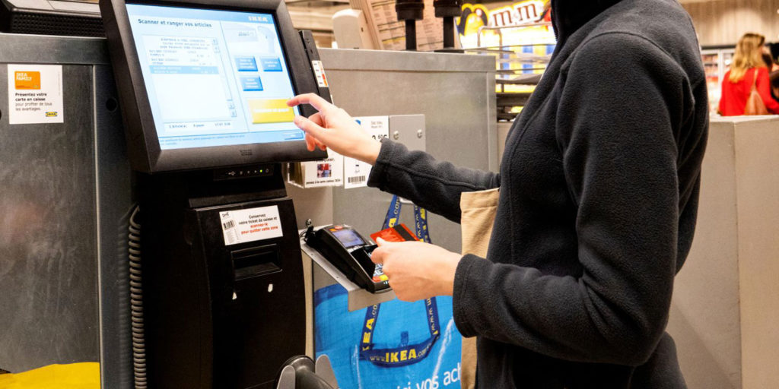
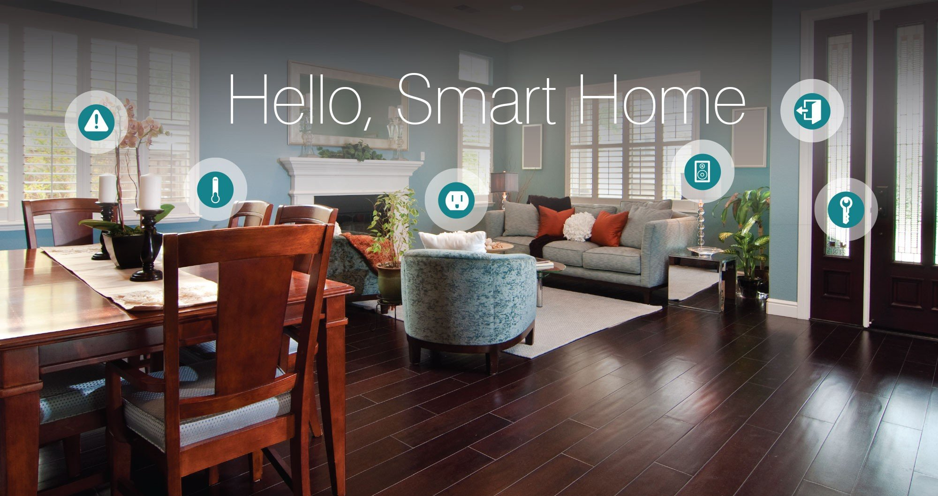
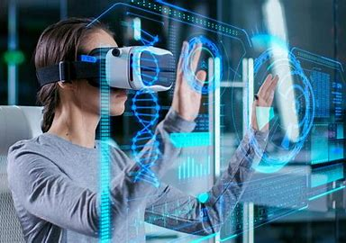
Real-World Applications
Websites and mobile apps
ATMs and self-checkout systems
Smart home devices
Voice assistants (e.g., Siri, Alexa)
Virtual reality interfaces

Slide 12
The Human

Slide 13
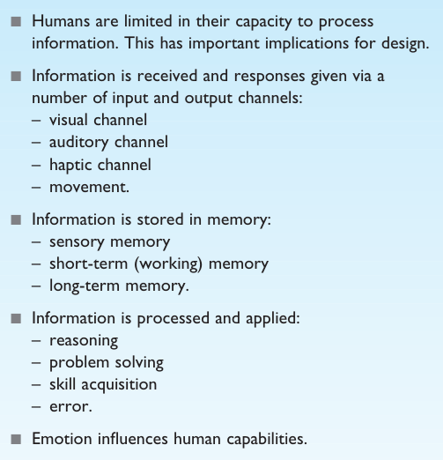
The human

Slide 14
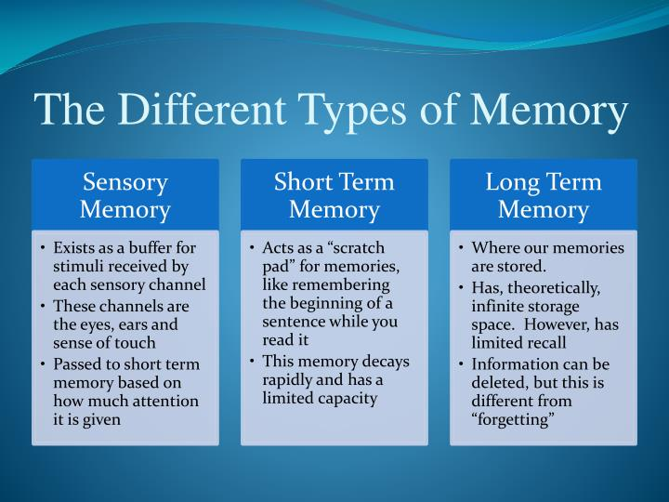
Memory

Slide 15
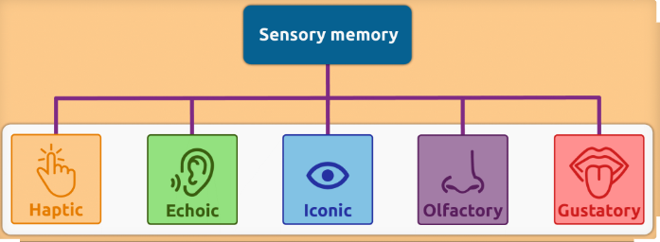

Slide 16
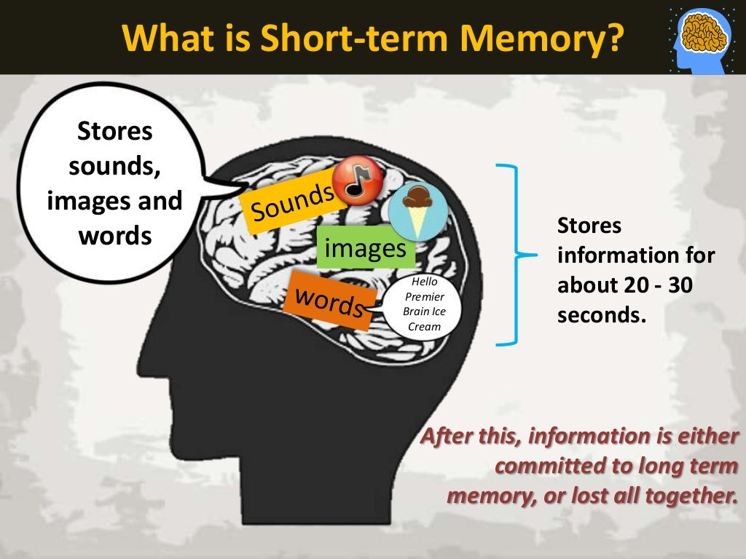
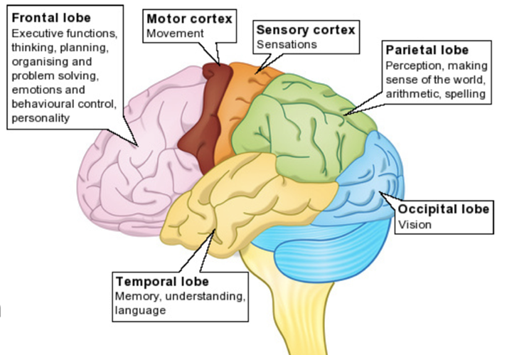
Scratch-pad for temporary recall
rapid access ~ 70ms
limited capacity - 7± 2 chunks

Slide 17
Short Term Memory
212348278493202
0121 414 2626
HEC ATR ANU PTH ETR EET
In experiments where subjects were able to recall words freely, evidence shows that recall of the last words presented is better than recall of those in the middle.
This is known as the recency effect.

Slide 18
Short Term Memory
limited capacity - 7± 2 chunks
The limited capacity of short-term memory produces a subconscious desire to create chunks, and so optimize the use of the memory.
The successful formation of a chunk is known as closure.

Slide 19
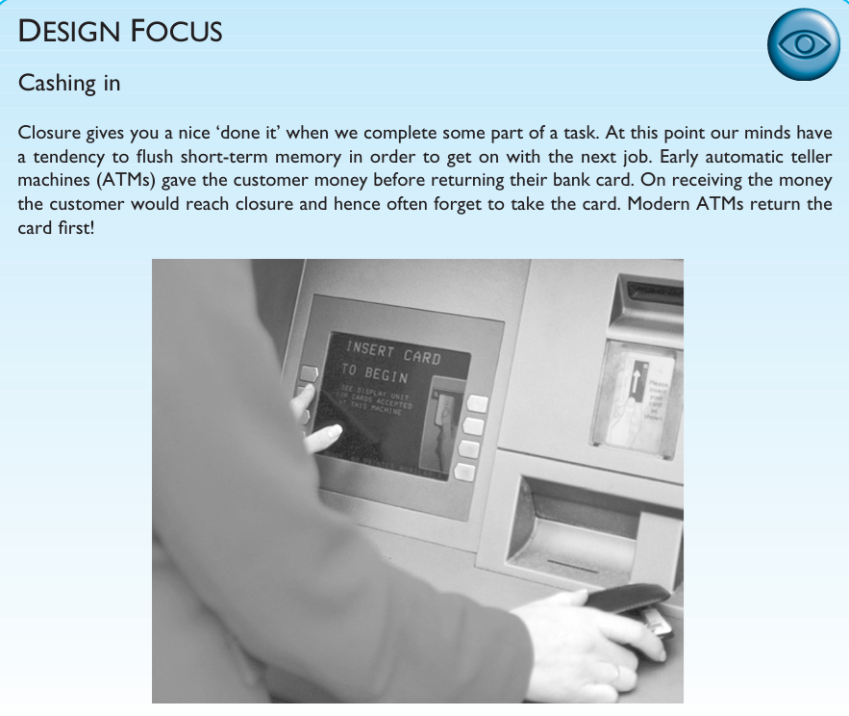

Slide 20
Long-term memory (LTM)
Repository for all our knowledge
slow access ~ 1/10 second
slow decay, if any
huge or unlimited capacity
Two types
episodic – serial memory of events
semantic – structured memory of facts, concepts, skills

Slide 21
Long-term memory - Episodic memory
Episodic memory represents our memory of events and experiences in a serial form.
It is from this memory that we can reconstruct the actual events that took place at a
given point in our lives.
Semantic memory, on the other hand, is a structured record of facts, concepts and skills that we have acquired.
The information in semantic memory is derived from that in our episodic memory, such that we can learn new facts or concepts from our experiences.

Slide 22
Long-term memory - Semantic memory
Semantic memory is structured in some way to allow access to information, representation of relationships between pieces of information, and inference.
One model for the way in which semantic memory is structured is as a network.
Model: semantic network (Given By: Collins and Quillian)
inheritance – child nodes inherit properties of parent nodes
Semantic networks represent the associations and relation ships between single items in memory.
supports inference through inheritance

Slide 23
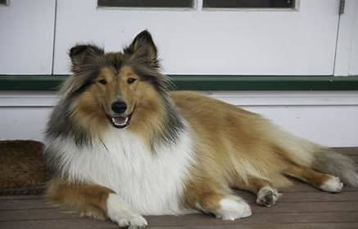
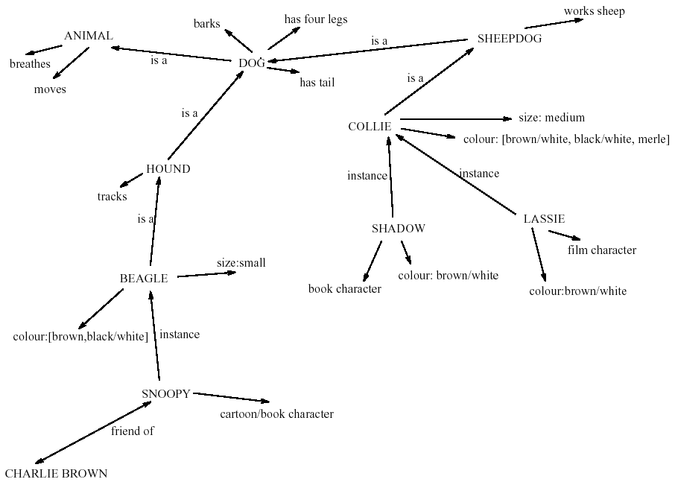
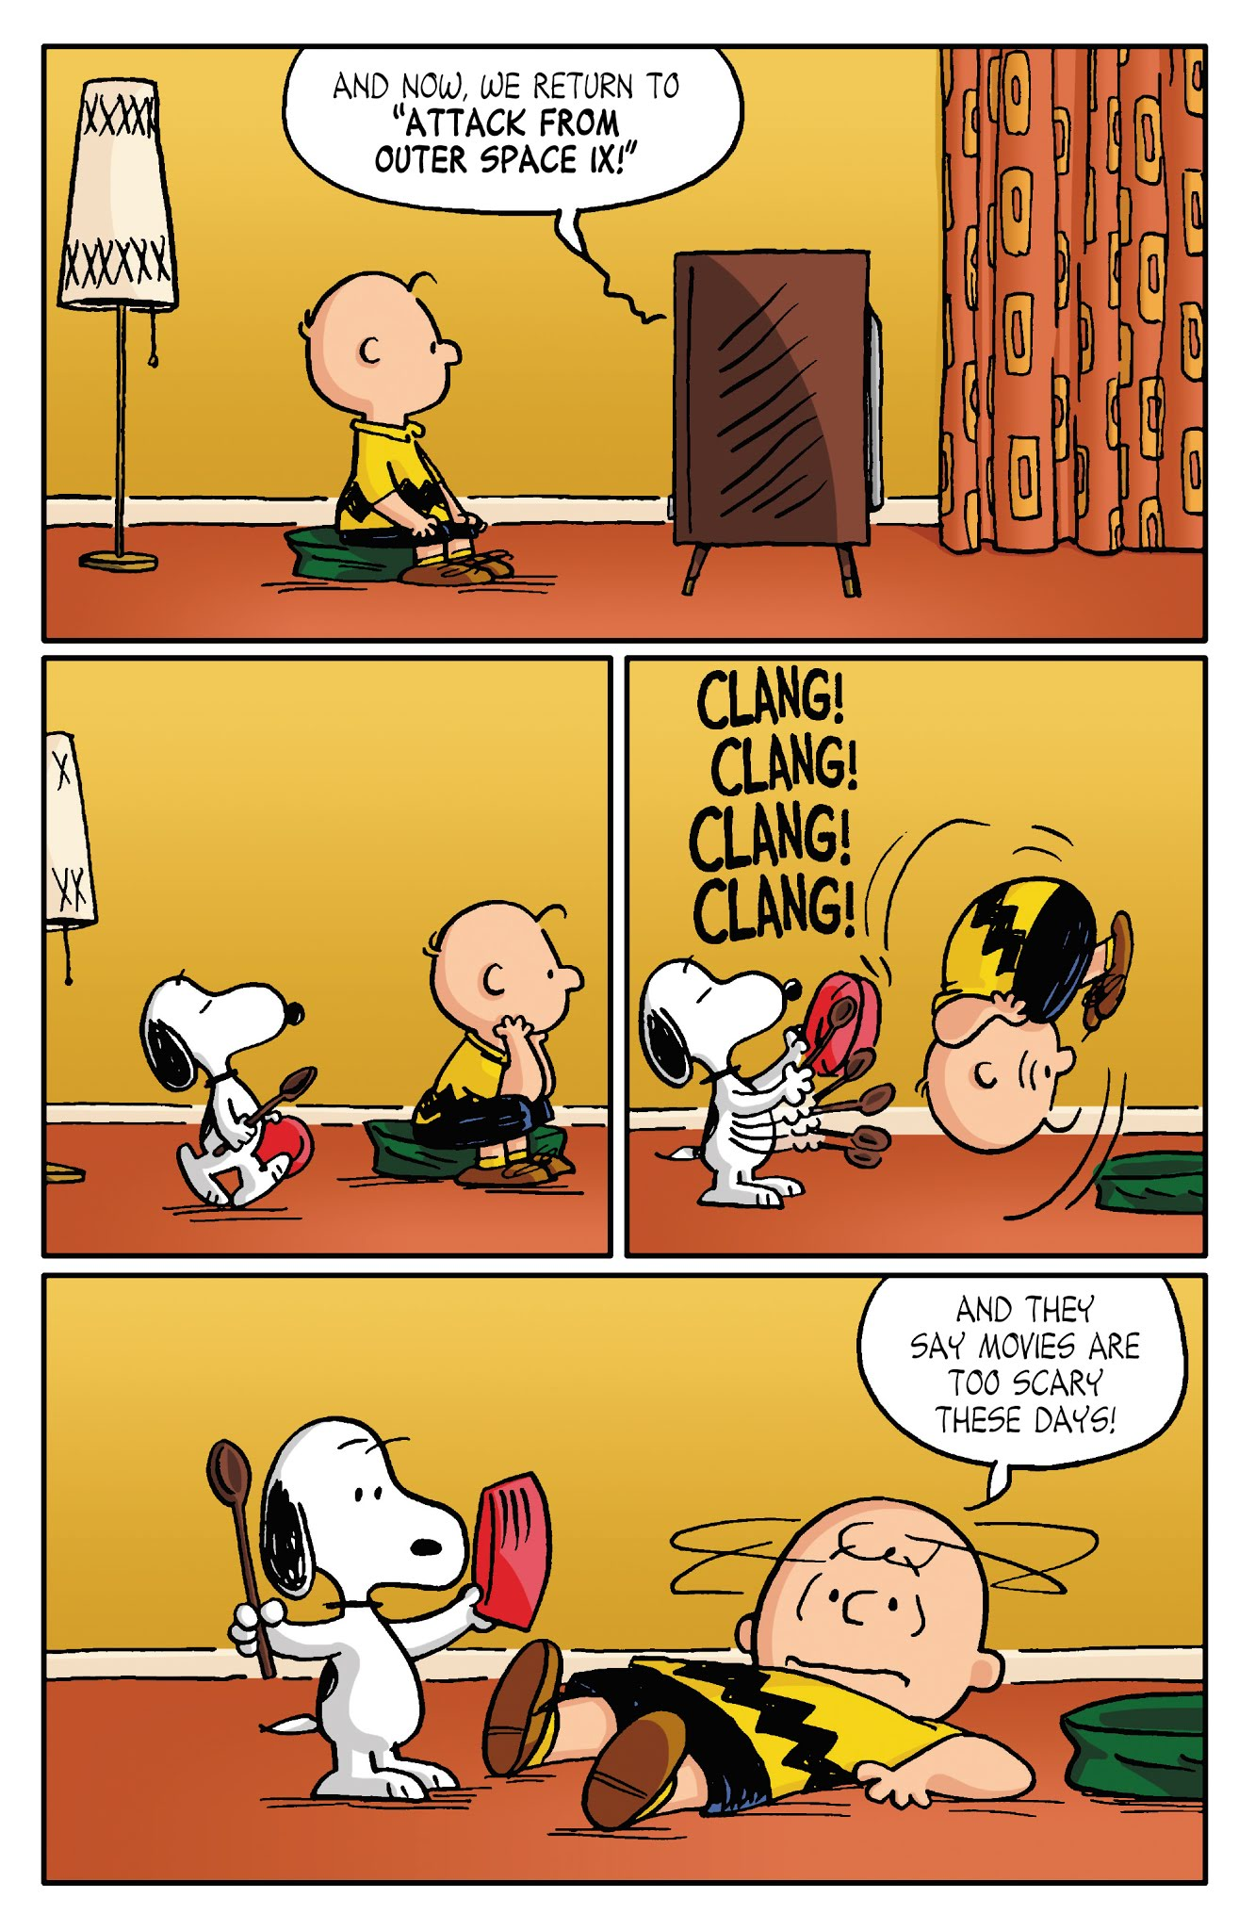
LTM - semantic network
1943 film “Lassie Come Home”
Shadow is the wise and loyal Golden Retriever from the classic 1993 movie Homeward Bound: The Incredible Journey.

Slide 24
Models of LTM - Frames
Structured representations such as frames and scripts organize information into data structures.
Information organized in data structures
Slots in structure instantiated with values for instance of data
Type–subtype relationships
DOG
Fixed
legs: 4
Default
diet: carniverous
sound: bark
Variable
size: colour
COLLIE
Fixed
breed of: DOG
type: sheepdog
Default
size: 65 cm
Variable
colour

Slide 25
Models of LTM - Scripts
Model of stereotypical information required to interpret situation
Script has elements that can be instantiated with values for context
Script for a visit to the vet
Entry conditions: dog ill
vet open
owner has money
Result: dog better
owner poorer
vet richer
Props: examination table
medicine
instruments
Roles: vet examines
diagnoses
treats
owner brings dog in
pays
takes dog out
Scenes: arriving at reception
waiting in room
examination
paying
Tracks: dog needs medicine
dog needs operation

Slide 26
Models of LTM - Scripts

Slide 27
Models of LTM - Production rules
Another type of knowledge representation which we hold in memory is the representation of procedural knowledge, our knowledge of how to do something.
A common model for this is the production system.
Condition–action rules are stored in long-term memory.
Condition/action rules
if condition is matched
then use rule to determine action.
IF dog is wagging tail
THEN pat dog
IF dog is growling
THEN run away

Slide 28
LTM - processes : storage
There are three main activities related to long-term memory: storage or remembering of information, forgetting and information retrieval.
rehearsal
information moves from STM to LTM
total time hypothesis
amount retained proportional to rehearsal time
distribution of practice effect
optimized by spreading learning over time
structure, meaning and familiarity
information easier to remember

Slide 29
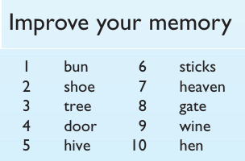

Slide 30
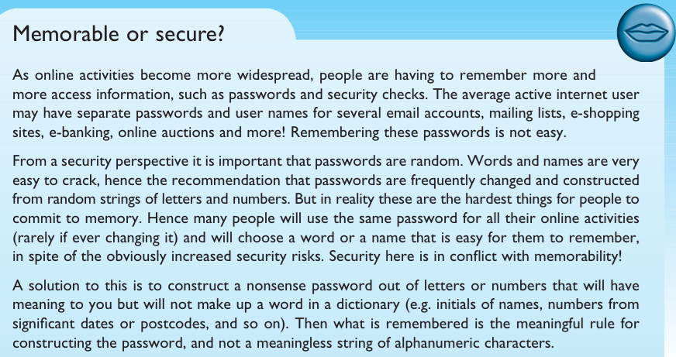

Slide 31
LTM - Forgetting
decay
information is lost gradually but very slowly
interference
new information replaces old: retroactive interference
old may interfere with new: proactive inhibition
so may not forget at all memory is selective …
… affected by emotion – can subconsciously `choose' to forget

Slide 32
LTM - retrieval
Recall
information reproduced from memory can be assisted by cues, e.g. categories, imagery
Recognition
information gives knowledge that it has been seen before
less complex than recall - information is cue

Slide 33
Input / Output channels
A person’s interaction with the outside world occurs through information being received and sent : input and output.
Vision
Two stages in vision
• physical reception of stimulus
• processing and interpretation of stimulus

Slide 34
The Eye - physical reception
The retina has specialized nerve cells called ganglion cells.
Y-cells more widely distributed in retina are responsible for the early detection of movement
There are two types: X-cells- in Fovea responsible for the early detection of pattern
The blind spot has no rods or cones, yet our visual system compensates for this so that in normal circumstances we are unaware of it.

Slide 35
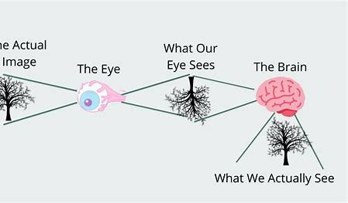
The Eye - physical reception
Vision begins with light.
Eye : Mechanism for receiving light and transforming it into electrical signals that are interpreted by the brain.
Light is reflected from objects in the world and their image is focused upside down on the back of the eye.
The receptors in the eye transform it into electrical signals which are passed to the brain.
The eye has a number of important components : The cornea and lens at the front of the eye focus the light into a sharp image on the back of the eye, the retina.
Images are focused upside-down on retina.

Slide 36
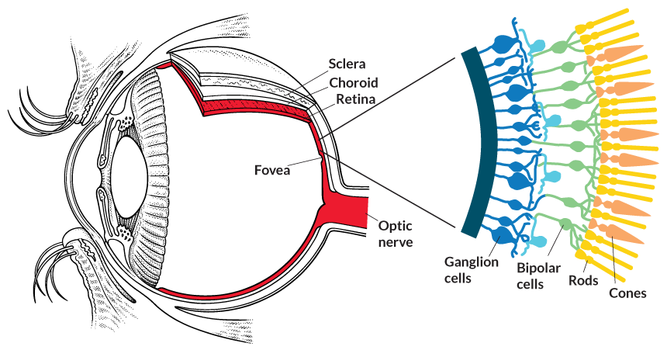
The Eye - physical reception
The retina is light sensitive and contains two types of photoreceptors: rods for low light vision and cones for colour vision.
Rods are highly sensitive to light and therefore allow us to see under a low level of illumination.
However, they are unable to resolve fine detail and are subject to light saturation.
This is the reason for the temporary blindness we get when moving from a darkened room into sunlight: the rods have been active and are saturated by the sudden light.
The retina also has specialized nerve cells called ganglion cells.

Slide 37
The Eye - physical reception
Cones are the second type of receptor in the eye.
They are less sensitive to light than the rods and can therefore tolerate more light.
There are three types of cone, each sensitive to a different wavelength of light.
This allows color vision.
The eye has approximately 6 million cones, mainly concentrated on the fovea, a small area of the retina on which images are fixated.

Slide 38
Visual perception - Interpreting the signal
Perceiving size and depth
Size and depth
visual angle indicates how much of view object occupies (relates to size and distance from eye)
visual acuity is ability to perceive detail (limited)
familiar objects perceived as constant size (in spite of changes in visual angle when far away)
cues like overlapping help perception of size and depth

Slide 39
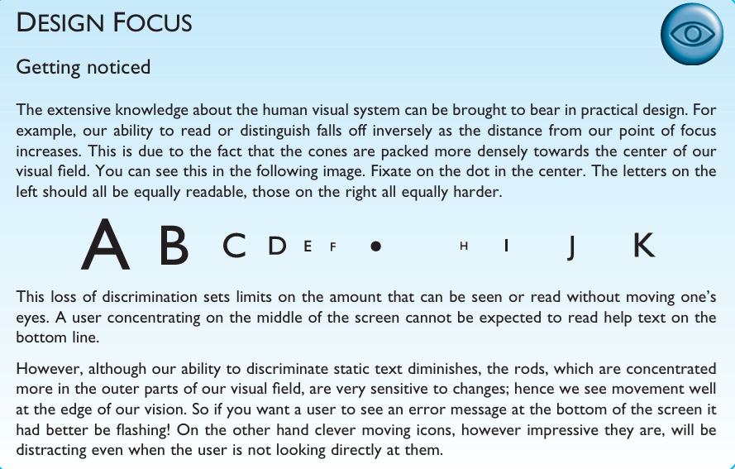

Slide 40
Interpreting the signal
if two objects are at the same distance, the larger one will have the larger visual angle.
reflected light from the object forms an upside-down image on the retina. The size of that image is specified as a visual angle.

Slide 41
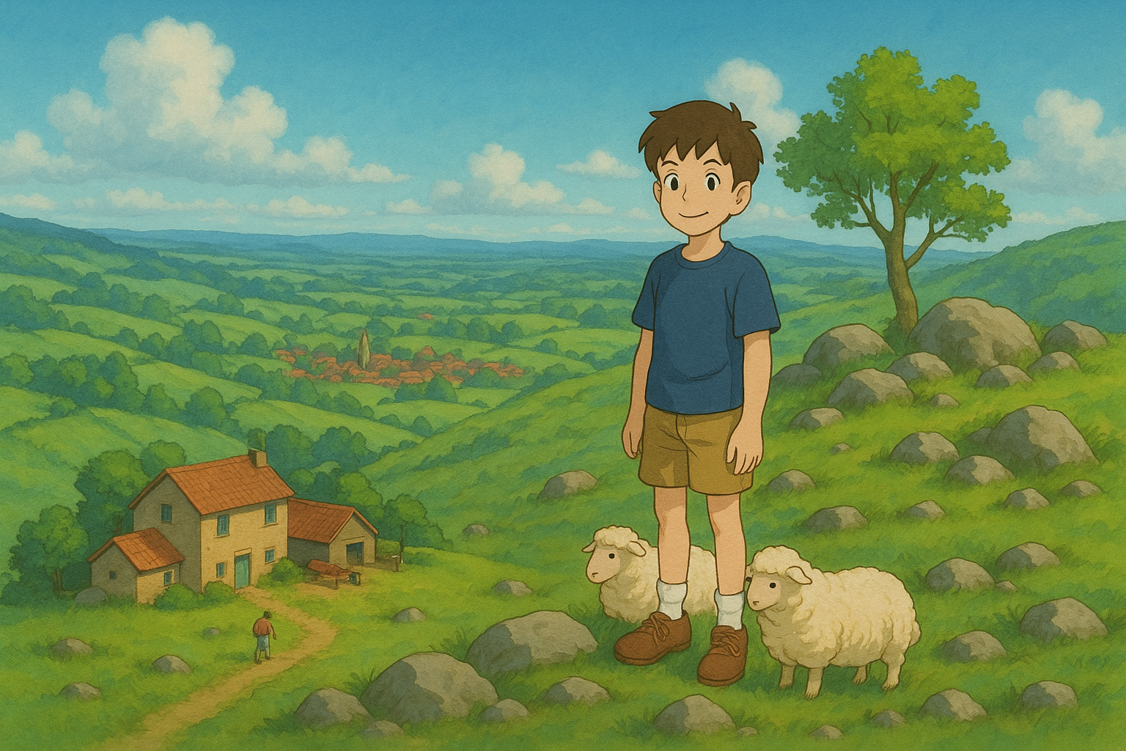
Interpreting the signal: Size and depth

Slide 42
Interpreting the signal (cont)
A second aspect of visual perception is the perception of brightness.
Brightness
subjective reaction to levels of light
affected by luminance of object
measured by just noticeable difference
visual acuity increases with luminance as does flicker
Colour
made up of hue, intensity, saturation
cones sensitive to colour wavelengths
blue acuity is lowest
8% males and 1% females colour blind

Slide 43
Interpreting the signal (cont)
The visual system compensates for:
movement
changes in luminance.
Context is used to resolve ambiguity
Optical illusions sometimes occur due to over compensation.

Slide 44
Visual Perception

Slide 45
Visual Perception

Slide 46
Visual Perception

Slide 47
Optical Illusions
the Ponzo illusion
the Muller Lyer illusion
These illusions demonstrate that our perception of size is not completely reliable.

Slide 48
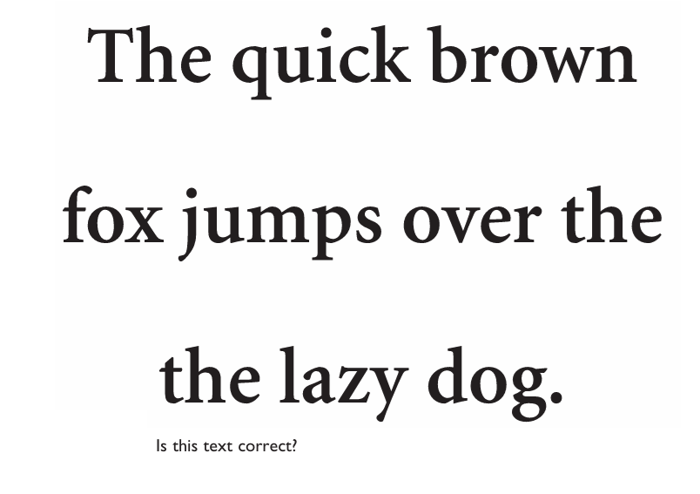
Optical Illusions
illusion created by our expectations

Slide 49
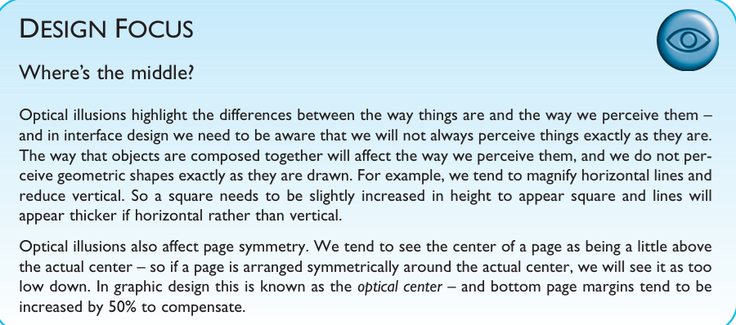

Slide 50
Reading
Design Focus : textual display
Several stages:
visual pattern perceived
decoded using internal representation of language
interpreted using knowledge of syntax, semantics, pragmatics
During reading, the eye makes jerky movements called saccades followed by fixations.
Perception occurs during the fixation periods, which account for approximately 94% of the time elapsed.
The eye moves backwards over the text as well as forwards, in what are known as regressions.
If the text is complex there will be more regressions.
Word shape is important to recognition.
Adults read approximately 250 words a minute.

Slide 51
 | Syntax | Semantics | Pragmatics
Definition | Rules about sentence structure (grammar). | Rules about literal meaning of words and sentences. | How context and intention affect meaning.
Main Question | “Is it grammatically correct?” | “Does it make literal sense?” | “What does the speaker really mean here?”
Example | "School to goes she." (Wrong order) "She goes to school." | (Correct) "The cat sat on the mat." — literal meaning is clear. (Wrong) "Colorless green ideas sleep furiously." — grammatically fine but meaning is unclear. | (Correct) "Can you open the window?" — literally a question about ability, but the intent is to politely ask to open the window.
Invalid When... | Sentence structure is wrong. | Words are correct but the meaning is unclear. | Sentence makes sense but is used in the wrong situation.
how we say it. what we say. why/how we say it in context

Slide 52
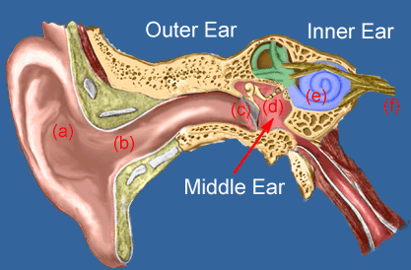
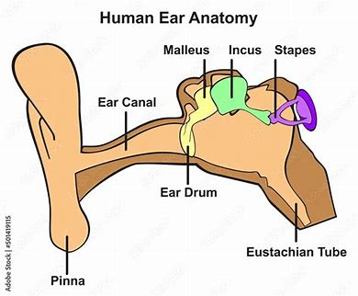
Hearing
The outer ear has two parts:
pinna : the structure attached to the sides of the head, and
auditory canal : sound waves are passed to the middle ear.
Provides information about environment: distances, directions, objects etc.
Physical apparatus:
outer ear – protects inner and amplifies sound
middle ear – transmits sound waves as vibrations to inner ear
inner ear – chemical transmitters are released and cause impulses in auditory nerve
The middle ear is a small cavity
connected to the outer ear by the tympanic
membrane, or ear drum, and to the
inner ear by the cochlea.
The waves are passed into the liquid-filled cochlea in the inner ear.

Slide 53
Hearing (cont)
sound is changes or vibrations in air pressure.
Sound
pitch – sound frequency
loudness – amplitude
timbre – type or quality
Humans can hear frequencies from 20Hz to 15kHz
It can distinguish frequency changes of less than 1.5 Hz at low frequencies but is less accurate at high frequencies..
Auditory system filters sounds
can attend to sounds over background noise.
for example, the cocktail party phenomenon (selective hearing reaches its highest level of expression: at a party)

Slide 54
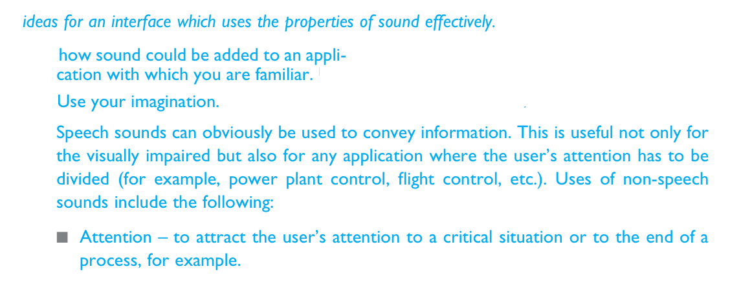
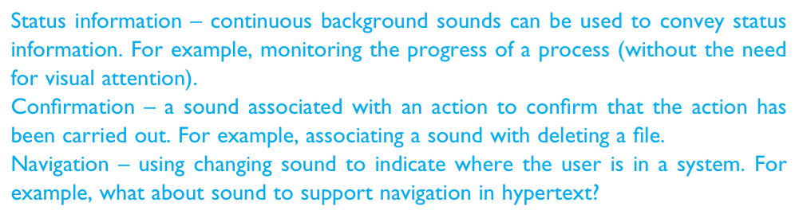
Design Focus

Slide 55
Touch
The third and last of the senses that to be considered for input is touch or haptic perception.
Provides important feedback about environment.
May be key sense for someone who is visually impaired.
skin contains three types of sensory receptor:
thermoreceptors – heat and cold
nociceptors – pain
mechanoreceptors – pressure (some instant, some continuous)
Some areas more sensitive than others e.g. fingers.
A second aspect of haptic perception is kinesthesis: awareness of the position of the body and limbs.
affects comfort and performance. For example, for a touch typist, awareness of the relative positions of the fingers and feedback from the keyboard are very important.

Slide 56
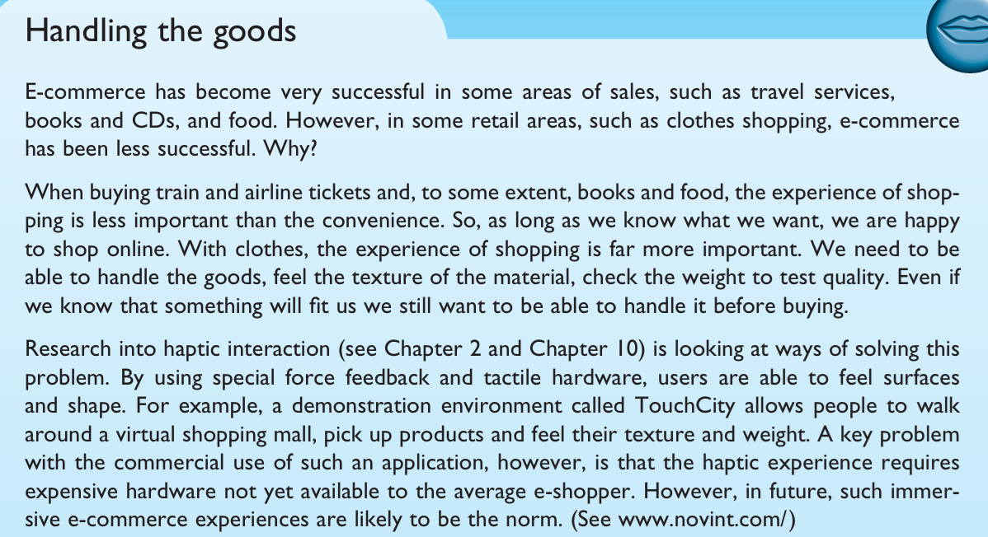
Design Focus

Slide 57
Movement
How motor control and how the way we move affects our interaction with computers?
Time taken to respond to stimulus: reaction time + movement time
Movement time dependent on age, fitness etc.
Reaction time - dependent on stimulus type:
A person can react to signals of type
visual ~ 200ms
auditory ~ 150 ms
pain ~ 700ms
A second measure of motor skill is accuracy.
Whether speed of reaction results in reduced accuracy?
video games where less skilled users fail at levels of play that require faster responses.

Slide 58
Movement (cont)
Speed and accuracy of movement are important considerations in the design of interactive systems, primarily in terms of the time taken to move to a particular target on a screen.
The time taken to hit a target is a function of the size of the target and the distance that has to be moved.
Fitts' Law describes the time taken to hit a screen target:
Movement time = a + b log₂(D/S + 1)
where: a and b are empirically determined constants
D is Distance
S is Size of target
targets as large as possible distances as small as possible
Fitts' Law helps UI designers optimize the placement and size of interactive elements like buttons, icons, and menus to enhance usability and speed.

Slide 60

Thinking
Process
Reasoning
deduction, induction, abduction
Problem solving

Slide 61
Thinking - Reasoning
Reasoning is the process by which we use the knowledge we have to draw conclusions or infer something new about the domain of interest.
Types of reasoning
deductive, inductive and abductive.

Slide 62
Deductive Reasoning
Deduction:
derive logically necessary conclusion from given premises.
e.g. All humans are mortal.
Socrates is a human.
Conclusion: Therefore, Socrates is mortal.
Logical conclusion not necessarily true.
If the premises are true, the conclusion must be true.

Slide 63
Inductive Reasoning
generalize from cases seen to cases unseen
e.g. all elephants we have seen have trunks therefore all elephants have trunks.
The conclusion is likely, but not guaranteed.

Slide 64
Abductive reasoning
Inference to the best explanation based on available evidence.
Reasoning from event to cause
e.g. Sam drives fast when drunk.
If I see Sam driving fast, assume drunk.
Unreliable:
The conclusion is a best guess, not certain.

Slide 65
Deductive Reasoning | Inductive Reasoning | Abductive Reasoning
Derives specific conclusions from general rules or premises. | Derives general rules from specific observations or examples. | Infers the most likely explanation from incomplete or partial data.
General → Specific | Specific → General | Incomplete Information → Best Explanation
Certain (if premises are true and logic is valid) | Probable (based on observed patterns) | Likely (best guess, not guaranteed)
Situation: Car won't start Rule: If battery is dead → car won’t start Fact: Battery is dead | Situation: Car won’t start Past experience: Battery was the cause before | Situation: Car won’t start Observations: Dim lights, no sound → Battery might be dead
Therefore, car won’t start (logically valid) | Therefore, dead battery is probably the cause | Therefore, the most likely cause is a dead battery

Slide 66
Problem solving
Reasoning is a means of inferring new information from what is already known.
Problem solving is the process of finding a solution to an unfamiliar task, using the knowledge we have.
Several theories:
Gestalt Theory (proximity, similarity, continuity, connectedness, and closure) - If we want to solve a problem we have to reorganize its components to discover a new solution.
problem solving involves both productive and reproductive thinking
Productive thinking consists in carrying out creative reorganizations of the elements of the problems in order to solve them.
Reproductive thinking is limited to applying the previous knowledge in a mechanical way.
Gestalt theory insists on using productive thinking, which will help us to reach insight.

Slide 67
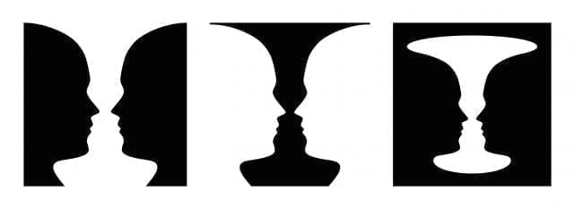


Gestalt Theory (proximity, similarity, continuity, connectedness, and closure)
Rubin’s glass: we simplify what we perceive and prefer simplicity.
Proximity:we perceive the objects in each box as a single block
Gestalt Theory-Good continuity

Slide 68
Problem solving (cont.)
Problem space theory
Newell and Simon proposed that problem solving centers on the problem space.
problem space comprises problem states
problem solving involves generating states using legal operators
heuristics may be employed to select operators e.g. means-ends analysis: Inthe initial state is compared with the goal state and an operator chosen to reduce the difference between the two
operates within human information processing system e.g. STM limits etc.
largely applied to problem solving in well-defined areas e.g. puzzles rather than knowledge intensive areas

Slide 69
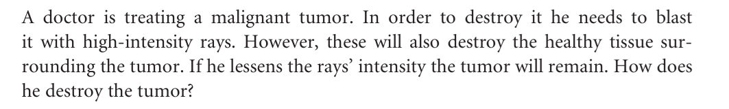
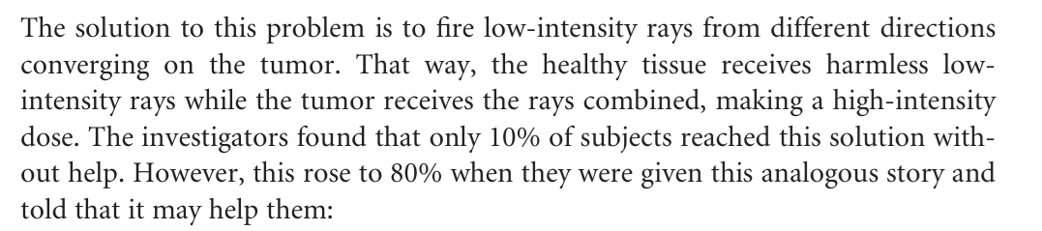
Problem solving (cont.)
Analogy
analogical mapping:
how people solve novel problems?
use knowledge of similar problem from similar domain
analogical mapping difficult if domains are semantically different

Slide 70
Problem solving (cont.)
Skill acquisition
All of the problem solving that we have considered so far has concentrated on handling unfamiliar problems.
However, for much of the time, the problems that we face are not completely new. Instead, we gradually acquire skill in a particular domain area.
A commonly studied domain is chess playing.
Skilled behavior within the context of the problem space theory of problem solving.
skilled computer programmers - can reconstruct programs more effectively than novices since they have the structures available to build appropriate chunks.
They acquire plans representing code to solve particular problems.

Slide 71
Errors and mental models
How it happens ?
some errors result from changes in the context of skilled behavior.
result from an incorrect understanding, or model, of a situation or system.
Types of error
slips
right intention, but failed to do it right
causes: poor physical skill, inattention etc.
change to aspect of skilled behaviour can cause slip
Email Sent to the Wrong Person
Accidentally selects a similarly named contact in the email list (e.g., John Smith instead of John Smythe).
Outcome: Sensitive information is leaked — not because of lack of knowledge or bad intent, but due to a lapse in execution.
A teacher intends to upload the QP for a Course, but uploads the Scheme for the Course by mistake.

Slide 72
Errors and mental models
A teacher gives more homework to improve students' understanding.
incorrect understanding: Believing that more homework = better learning outcomes.
Types of error
mistakes
wrong intention
cause: incorrect understanding
humans create mental models to explain behaviour.
if wrong (different from actual system) errors can occur
An employee stores company passwords in a spreadsheet on their desktop for convenience.
incorrect understanding: They think it's safe since their computer is password-protected.

Slide 73
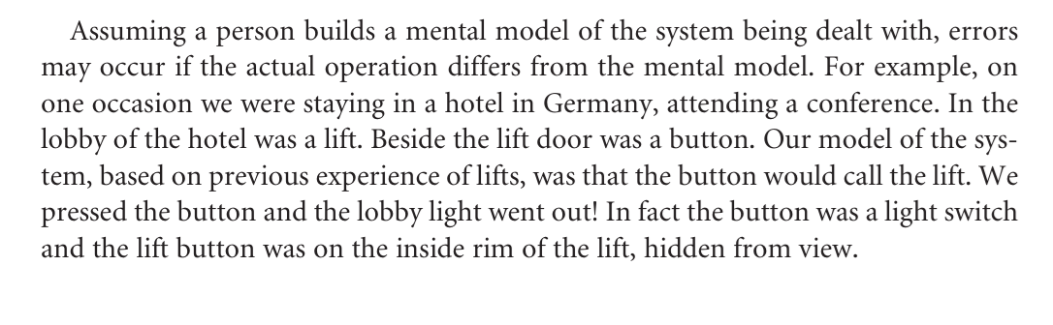
Errors and mental models

Slide 74
Emotion
Emotion clearly involves both cognitive and physical responses to stimuli
The biological response to physical stimuli is called affect
Affect influences how we respond to situations
positive → creative problem solving
negative → narrow thinking
“Negative affect can make it harder to do even easy tasks; positive affect can make it easier to do difficult tasks”
(Donald Norman)

Slide 75
Emotion (cont.)
Implications for interface design
stress will increase the difficulty of problem solving
relaxed users will be more forgiving of shortcomings in design
aesthetically pleasing and rewarding interfaces will increase positive affect
correct application generally requires understanding of context in psychology, and an understanding of particular experimental conditions.

Slide 76

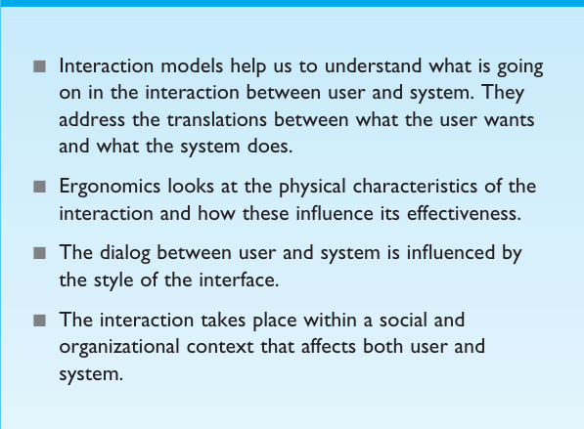

Slide 77
What is interaction?
communication
user  system
There are a number of ways in which the user can communicate with the system.
At one extreme is batch input, in which the user provides all the information to the computer at once and leaves the machine to perform the task.
This approach does involve an interaction between the user and computer but does not support many tasks well.
At the other extreme are highly interactive input devices and paradigms, such as direct manipulation and the applications of virtual reality
Here the user is constantly providing instruction and receiving feedback.

Slide 78
Some terms of interaction
domain – the area of work under study
e.g. graphic design
goal – what you want to achieve
e.g. create a solid red triangle
task – how you go about doing it – ultimately in terms of operations or actions
e.g. … select fill tool, click over triangle
Task analysis involves the identification of the problem space for the user of an interactive system in terms of the domain, goals, intentions and tasks.
We can use our knowledge of tasks and goals to assess the interactive system that is designed to support them.

Slide 79
Norman’s model
Norman’s model of interaction is one of the most influential model in Human–Computer Interaction, possibly because of its closeness to understanding user behavior and designing user-friendly systems.
Donald Norman’s model of interaction explains how users interact with a system by breaking it down into 7 stages.
The user formulates a plan of action, which is then executed at the computer interface.
When the plan, or part of the plan, has been executed, the user observes the computer interface to evaluate the result of the executed plan, and to determine further actions.

Slide 80
Donald Norman’s model
Seven stages
user establishes the goal
formulates intention
specifies actions at interface
executes action
perceives system state
interprets system state
evaluates system state with respect to goal
Norman’s model concentrates on user’s view of the interface

Slide 81

execution/evaluation loop
user establishes the goal
formulates intention
specifies actions at interface
executes action
perceives system state
interprets system state
evaluates system state with respect to goal

Slide 82
execution/evaluation loop
user establishes the goal
goal
execution
evaluation
system
Goal: "I want to send an email."

Slide 83
execution/evaluation loop
goal
execution
evaluation
system
Execution The user translates the goal into actions and performs them on the system.
Forming intention
Specifying actions
Executing actions
Opening the mail app, typing the message, clicking “Send.”

Slide 84
execution/evaluation loop
goal
execution
evaluation
system
System: The system responds to the user's actions. The mail is sent, and the screen updates.

Slide 85
execution/evaluation loop
goal
execution
evaluation
system
Evaluation The user observes the system's output and evaluates whether their goal has been achieved.
Perceiving system state
Interpreting it
Evaluating against the goal
User checks if the email is in the "Sent" folder.

Slide 86
Bridges in Norman’s model
Some systems are harder to use than others
Gulf of Execution
Difficulty translating goals into actions the system understands.
Gulf of Evaluation
– Difficulty understanding the system’s response.

Slide 87
Human error - slips and mistakes
slip
understand system and goal
correct formulation of action
incorrect action
mistake
may not even have right goal!
Fixing things?
slip – better interface design
mistake – better understanding of system

Slide 88
The interaction framework
extension of Norman…
The interaction framework attempts a more realistic description of interaction by including the system explicitly, and breaks it into four main components
user
input
system
output
The User begins the interactive cycle with the formulation of a goal and a task to achieve that goal.
The only way the user can manipulate the machine is through the Input.
The input language is translated into the core language as operations to be performed by the System.
The System then transforms itself as described by the operations; The current values of system attributes are rendered as concepts or features of the Output.
O
output
S
core
U
task
I
input

Slide 89
Abowd & Beale’s model
user intentions → translated into actions at the interface → translated into alterations of system state → reflected in the output display → interpreted by the user

Slide 90
Ergonomics
Ergonomics is the study of how people interact with technology and environments to enhance comfort, safety, efficiency, and performance.
Ergonomics (or human factors) is traditionally the study of the physical characteristics of the interaction: how the controls are designed, the physical environment in which the interaction takes place, and the layout and physical qualities of the screen.
A primary focus is on user performance and how the interface enhances or detracts from this. In seeking to evaluate these aspects of the interaction, ergonomics will certainly also touch upon human psychology and system constraints.
It is a large and established field, which is closely related to but distinct from HCI.

Slide 91
Ergonomics
The field of ergonomics addresses issues on the user side of the interface, covering both input and output, as well as the user’s immediate context.
Presentation and screen design relates to the output branch of the framework.
The entire framework can be placed within a social and organizational context that also affects the interaction.

Slide 92
Ergonomics - examples
arrangement of controls and displays
e.g. controls grouped according to function or frequency of use, or sequentially.
surrounding environment
e.g. seating arrangements adaptable to cope with all sizes of user
health issues
e.g. physical position, environmental conditions (temperature, humidity), lighting, noise
use of colour
e.g. use of red for warning, green for okay, awareness of colour-blindness etc.

Slide 93
Interaction styles
The choice of interface style have a profound effect on the interaction between user and computer.
The most common interface styles :
command line interface
menus
natural language
question/answer and query dialog
form-fills and spreadsheets
WIMP
point and click
three-dimensional interfaces

Slide 94
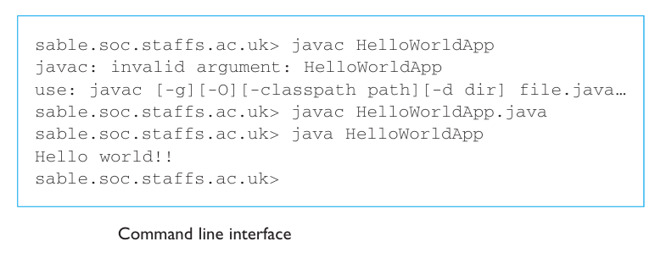
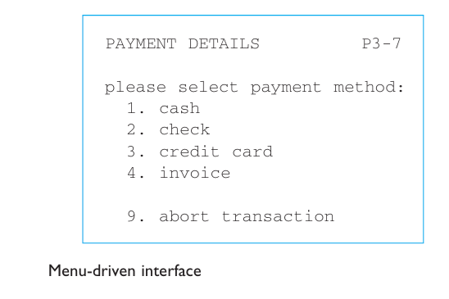
Command line interface
Way of expressing instructions to the computer directly
function keys, single characters, short abbreviations, whole words, or a combination
Menus

Slide 95
WIMP Interface
Windows
Icons
Menus
Pointers
… or windows, icons, mice, and pull-down menus!
default style for majority of interactive computer systems, especially PCs and desktop machines
Examples of WIMP interfaces include
Microsoft Windows for IBM PC compatibles, MacOS for Apple Macintosh compatibles and various X Windows-based systems for UNIX.

Slide 96
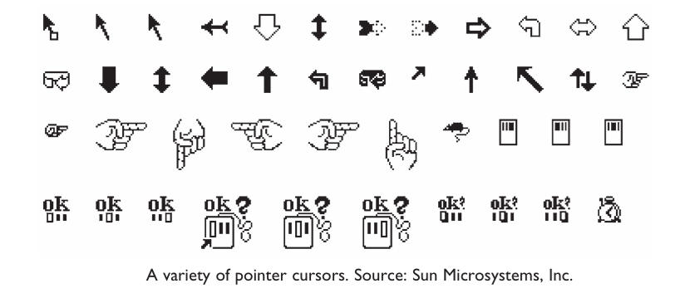
elements of the wimp interface
windows, icons, menus, pointers
also see supplementary material on choosing wimp elements

Slide 97
Experience, Engagement and Fun
Designing experience
Physical engagement
Managing value

Slide 98
Physical design
many constraints:
ergonomic – minimum button size
physical – high-voltage switches are big
legal and safety – Auto shutoff to prevent gas leaks
context and environment – easy to clean
aesthetic – must look good
economic – … and not cost too much!

Slide 99
Paradigm
Concerns
how can an interactive system be developed to ensure its usability?
how can the usability of an interactive system be demonstrated or measured?

Slide 100
Paradigms of interaction
New computing technologies arrive, creating a new perception of the human—computer relationship.
We can trace some of these shifts in the history of interactive technologies.

Slide 101
Reusability Paradigm
The reusability or reuse potential refers to the ability of a component or product to retain its functionality after the end of its primary life

Slide 102
The initial paradigm
Batch processing
Impersonal computing

Slide 103
Example Paradigm Shifts
Batch processing
Time-sharing
Interactive computing

Slide 104
Example Paradigm Shifts
Batch processing
Timesharing
Networking
@#$% !
???
Community computing

Slide 105
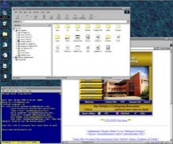
Example Paradigm Shifts
Batch processing
Timesharing
Networking
Graphical displays
Move this file here,
and copy this to there.
C…P… filename
dot star… or was
it R…M?
% foo.bar
ABORT
dumby!!!
Direct manipulation

Slide 106
Example Paradigm Shifts
Batch processing
Timesharing
Networking
Graphical display
Microprocessor
Personal computing

Slide 107
Example Paradigm Shifts
Batch processing
Timesharing
Networking
Graphical display
Microprocessor
WWW
Global information

Slide 108
Example Paradigm Shifts
Batch processing
Timesharing
Networking
Graphical display
Microprocessor
WWW
Ubiquitous Computing
A symbiosis of physical and electronic worlds in service of everyday activities.

Slide 109
Case Studies

Slide 110

Thank You

